Slide 1
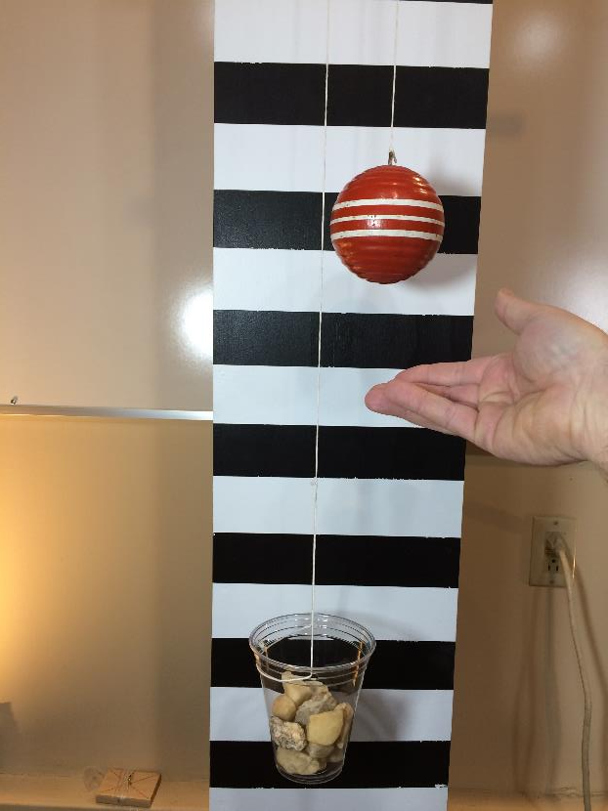
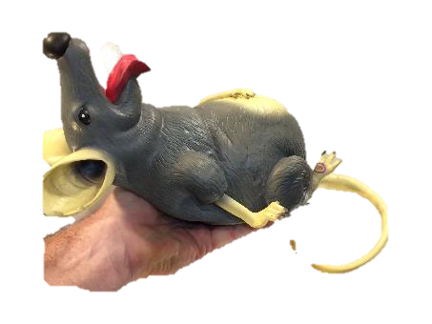
Work and Energy
Potential Energy
Suggested Experiments
LabRat Scientific
© 2018

Slide 2
Exp. 1 – Acceleration
Scientific Question
How do forces affect the acceleration of an object?
Equipment and Materials
Pulley Test Rig
Pulley, support beam, and clamps
Test Object (i.e wooden ball)
Smart Phone
Computer with external web cam
Weight Cup and Test Weights (small rocks, pennies, steel washers)
Sensitive scale (i.e. diet scale)

Slide 3
Exp. 1 – Acceleration
Approach:
Set up test rig
Attach test object (i.e. wooden ball) to one end of string passing through the pulley. Attach the weight cup to the end of the string
Weight test weight sample
Place weights into the weight cup
Run tests and observe results
Orient sample and position of reference mark on pulley
Start video recording
Release weights and observe motion
Stop video recording
Repeat Steps 3 – 5 for several different test weights

Slide 4
Notes:
Pulley
Friction will come into play. When selecting a pulley make sure it operates smoothly will minimal friction.
Select a pulley with a large diameter (2 inches is optimal)

Slide 5
Exp. 1 – Acceleration
Data Analysis
Review video data
Calculate velocity – you should notice is increases as the object moves (accelerates)
Plot velocity versus distance and time
Drawing Conclusions
Is the data linear
How does the weight of the test weights affect the motion

